Slide 1

Credit Default Prediction: Using Customer Behavior Patterns
Team Members:
Jeena Mole (G01460309)
Parshwa Gandhi (G01511122)
Krish Sanghvi (G01521041)
Notes:
1

Slide 2
Impact of Credit Card Defaults on the U.S. Economy and American Express
Effects on the U.S. Economy:
Effects on American Express:
Reduced Consumer Spending: High levels of defaults lead to reduced spending, which makes up a significant part of the U.S. economy. A decrease in spending can lead to slower economic growth.
Strained Financial System: Increased defaults strain the financial system, resulting in tighter credit conditions and higher borrowing costs for consumers and businesses.
Increased Unemployment Risk: As consumer spending declines and businesses experience reduced revenue, companies may cut costs, leading to layoffs and increased unemployment.
Increased Provisions for Losses: Higher default rates require American Express to set aside larger reserves to cover potential losses, impacting profitability.
Tighter Lending Standards: The company may restrict lending to manage risk, limiting growth opportunities.
Stock Performance Impact: Higher defaults can lower investor confidence, affecting stock prices.

Slide 3

Project Objective
The objective of this project is to predict the probability that a customer will not pay back their credit card balance amount in the future based on the monthly customer profile.

Slide 4
Literature Survey
RESEARCH PAPER | AUTHOR | FEATURES | MODELS USED | FINDINGS
A Hybrid Model for Credit Card Default Prediction | Tan, W., Yu, Z., Zheng, L. | Credit score, income, age, employment type, payment history | Neural Networks, K-Means Clustering | Hybrid model combining neural networks and clustering provides better prediction accuracy for high-risk users.
Predicting Credit Card Default with Support Vector Machines | Liao, T. W., Hsueh, S. H. | Age, income, education, credit utilization, marital status | Support Vector Machine (SVM) | SVM was able to achieve higher classification accuracy than logistic regression, especially for imbalanced data
Predicting Credit Card Default with Ensemble Learning | Huang, C., & Chen, Y. | Transaction data, payment status, income, balance, credit score | XGBoost, Random Forest, LightGBM | Ensemble methods like XGBoost and LightGBM performed best in terms of accuracy and recall, especially in imbalanced classes.
Notes:
4

Slide 5
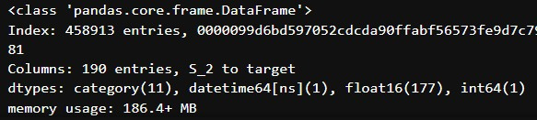
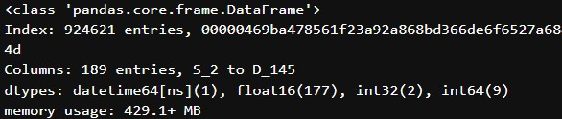
Dataset
Training Data : The training data begins on 03-01-2018 and ends on 03-31-2018.There are 458,913 customers in the training set and 190 columns.
In the training set, the last statement of all customers was in March 2018, while in the test set the date of customers' last statements range from April through October 2019.
Test Data : The test data begins on 04-01-2019 and ends on 10-31-2019.There are 924,621 customers in the test set and 189 columns.

Slide 6
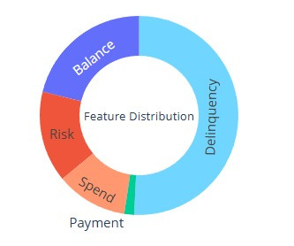
Dataset
The dataset contains aggregated profile features for each customer.
Features are anonymized and normalized, they fall into the following general categories:
D_*: Delinquency variables
S_*: Spend variables
P_*: Payment variables
B_*: Balance variables
R_*: Risk variables

Slide 7
P_ : Captures details about payments, such as amount paid, payment frequency, and payment-to-balance ratio.
Impact: Regular, timely payments reduce default likelihood, whereas insufficient payments or missed payments are strong predictors of default.
R_ : Measures risk-related factors, which may include customer risk scores, credit risk bands, or inferred risk metrics.
Impact: Directly quantifies the likelihood of default and is likely derived from historical data or statistical models.
Feature Representations
D_ : Indicates customer delinquency behavior, such as late payments, overdue balances, or missed payments.
Impact: High delinquency signals increased likelihood of future defaults.
S_ : Tracks customer spending patterns, such as monthly expenditures or spending trends.
Impact: High or erratic spending relative to income or credit limit may indicate financial strain and potential default.
B_ : Reflects account balances, including credit card balance, available credit, and trends in balance utilization.
Impact: High balance utilization (e.g., consistently maxing out a credit card) can suggest higher default risk.

Slide 8
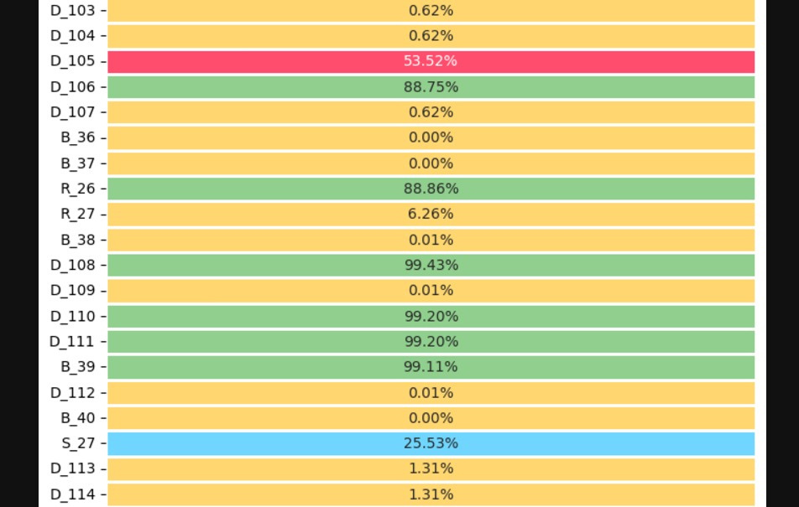
Exploratory Data Analysis (EDA)
Due to the dataset size, we use the compressed version of the train and test sets AMEX-Feather-Dataset and took the last statement for each customer. So, training and testing data are loaded from Feather files.
Grouping data by customer_ID and selecting the last row for each customer to ensure data consistency and relevance. The datasets are indexed by customer_ID for easier lookup and manipulation.
The S_2 column, representing dates, was converted to a datetime format, enabling temporal analysis.
Missing values were quantified and visualized with a heatmap to identify patterns in missing data for informed imputation strategies.
Notes:
8

Slide 9
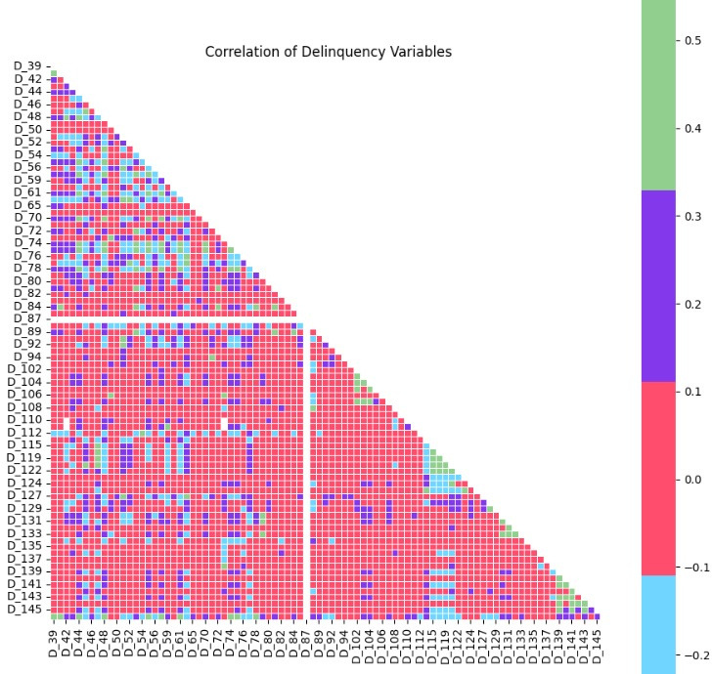
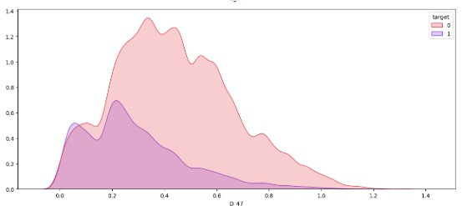
Exploratory Data Analysis (EDA)
Correlation heatmaps for feature groups were created to assess inter-feature relationships.
1. DELINQUENCY
Kernel Density Estimation (KDE) plots were generated for feature groups to understand their distributions and relationships with the target.
Notes:
9

Slide 10
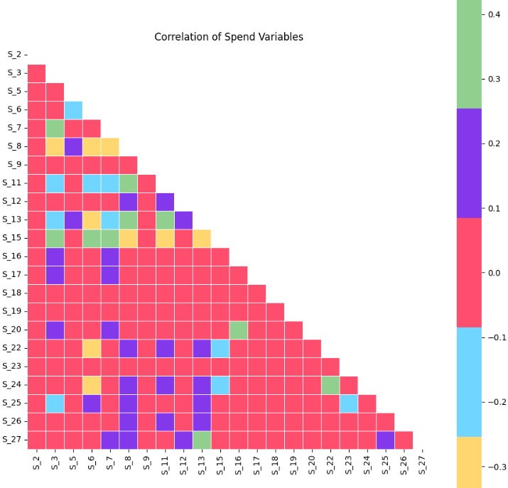
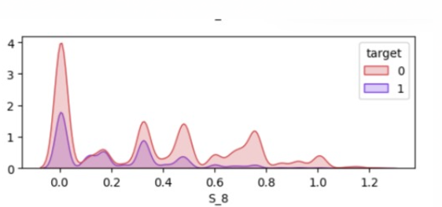
Exploratory Data Analysis (EDA)
Correlation heatmaps for feature groups were created to assess inter-feature relationships.
2. SPEND
Kernel Density Estimation (KDE) plots were generated for feature groups to understand their distributions and relationships with the target.
Notes:
10

Slide 11
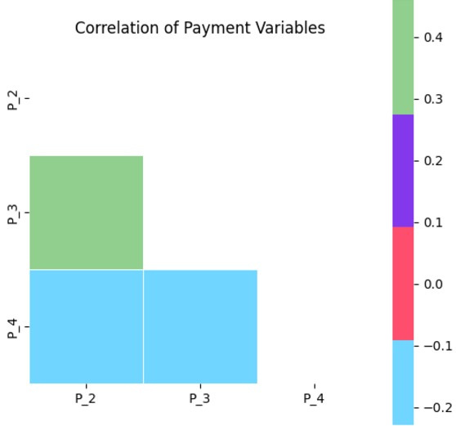
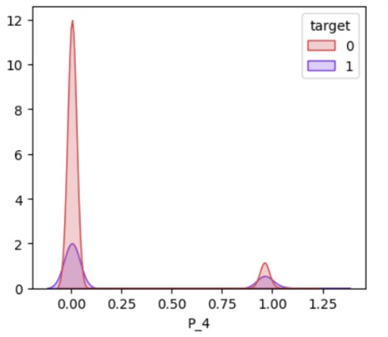
Exploratory Data Analysis (EDA)
Correlation heatmaps for feature groups were created to assess inter-feature relationships.
3. PAYMENT
Kernel Density Estimation (KDE) plots were generated for feature groups to understand their distributions and relationships with the target.
Notes:
11

Slide 12
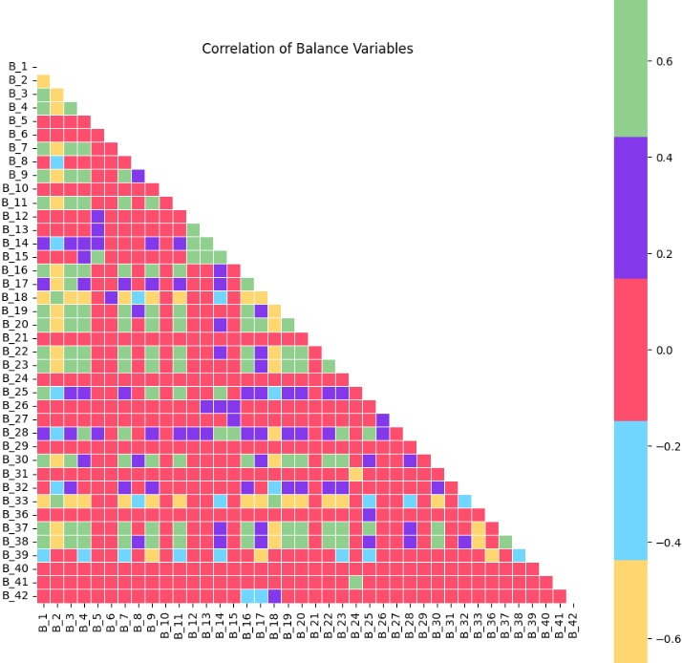
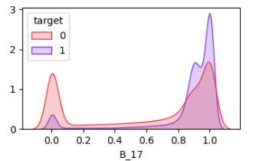
Exploratory Data Analysis (EDA)
Correlation heatmaps for feature groups were created to assess inter-feature relationships.
4. BALANCE
Kernel Density Estimation (KDE) plots were generated for feature groups to understand their distributions and relationships with the target.
Notes:
12

Slide 13
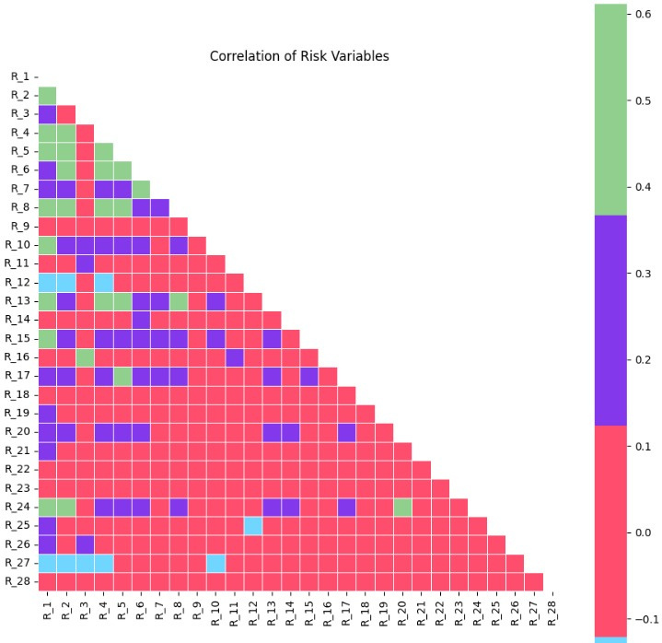
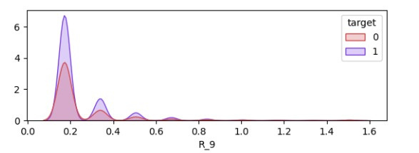
Exploratory Data Analysis (EDA)
Correlation heatmaps for feature groups were created to assess inter-feature relationships.
5. RISK
Kernel Density Estimation (KDE) plots were generated for feature groups to understand their distributions and relationships with the target.
Notes:
13

Slide 14
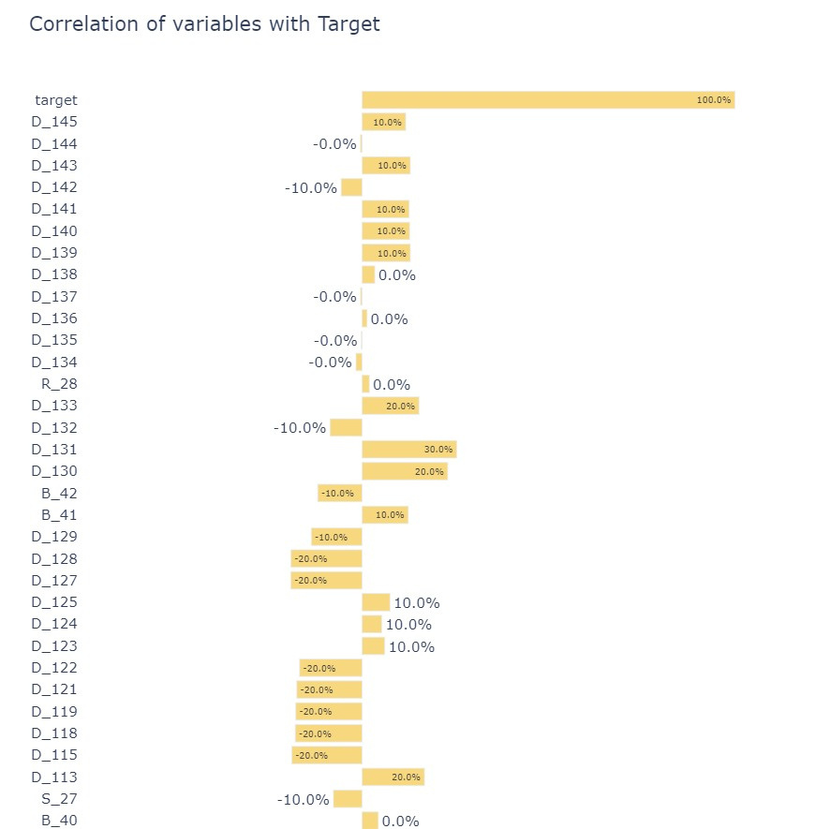
Exploratory Data Analysis (EDA)
Correlation plot showing the correlation of various variables with the target variable in the American Express Default Prediction competition.
This plot can guide you to create or select features that are more likely to contribute meaningfully to the model’s performance. For example, you might decide to combine features with similar correlation patterns or drop features with little predictive value.
Notes:
14

Slide 15
Feature Selection
Correlation matrices and graphs play a key role in guiding the feature selection, model understanding, and the refinement of the CatBoost model used for the American Express Default Prediction. Below is a breakdown of how these exploratory data analysis (EDA) steps, specifically the correlation matrices and distribution graphs, have been used in this model development:
Feature Engineering & Selection: Use correlation matrices to identify features strongly related to the target variable, such as delinquency or spending patterns, which may indicate default risks. Address multicollinearity by removing redundant features, ensuring the model remains stable and interpretable.
Example:
If a delinquency-related feature (e.g., D_114 , D_116 , D_117 , D_120) shows a strong positive correlation with the target, this indicates that this feature is important for predicting default and should be included in the model.
if two features such as B_30 and B_38 have a high correlation, one of them might be removed to reduce multicollinearity in the model, making the CatBoost model more stable and interpretable.
features like B_30, S_5 (if not correlated with the target or the other features) can be excluded to focus on more relevant features that improve the model's predictive power.
Identifying Class Imbalance: Analyze the target distribution to detect class imbalance, such as significantly more non-defaults, and adjust class weights in CatBoost to prevent bias toward the majority class. Techniques like weighted training improve the model’s ability to predict rare default cases.
Notes:
15

Slide 16
Feature Selection
Visualizing Feature Distributions: Leverage KDE plots to understand how features like delinquency or spending separate between target classes, highlighting those with strong discriminative power. Features with clear separation between defaults and non-defaults should be prioritized for training.
Data Quality Check & Missing Values Handling: Use heatmaps to identify features with significant missing data and decide whether to impute, exclude, or let CatBoost handle them directly. Proper handling of missing values improves model reliability and prevents data biases.
Improving Model Performance: Evaluate feature importance post-training to confirm which features contribute most to predictions, focusing on those that align with pre-training insights. Iterative refinement based on importance ensures optimized predictive power.
Label Encoding for Categorical Features: Encode categorical variables like such as B_30, B_38 , D_116, D_117 are relevant and should be included in the encoding process. LabelEncoder, enabling CatBoost to process them effectively without resorting to one-hot encoding. This reduces complexity while maintaining predictive quality.
Notes:
16

Slide 17
Model Selection
XGBoost (Extreme Gradient Boosting) is a highly optimized implementation of the gradient boosting algorithm, a technique that builds an ensemble of weak learners (decision trees) to form a strong predictive model.
CatBoost (Categorical Boosting) is another gradient boosting algorithm specifically designed to handle categorical features without requiring heavy preprocessing, such as one-hot encoding or label encoding. This ability to work directly with categorical data is especially valuable in financial applications where categorical variables (e.g., transaction types, customer demographics) are prevalent.
LightGBM (Light Gradient Boosting Machine) is a gradient boosting framework that excels in handling large datasets efficiently. Unlike traditional boosting algorithms, LightGBM uses techniques like Gradient-based One-Side Sampling (GOSS) and Exclusive Feature Bundling (EFB) to reduce memory usage
Notes:
17

Slide 18
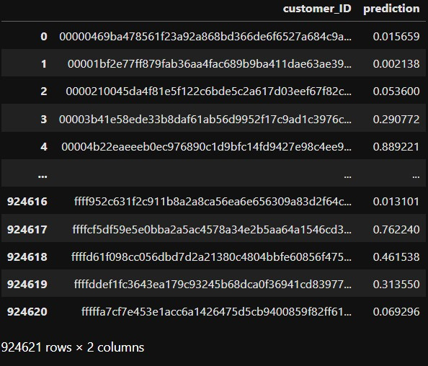
Model Predictions
Notes:
18

Slide 19
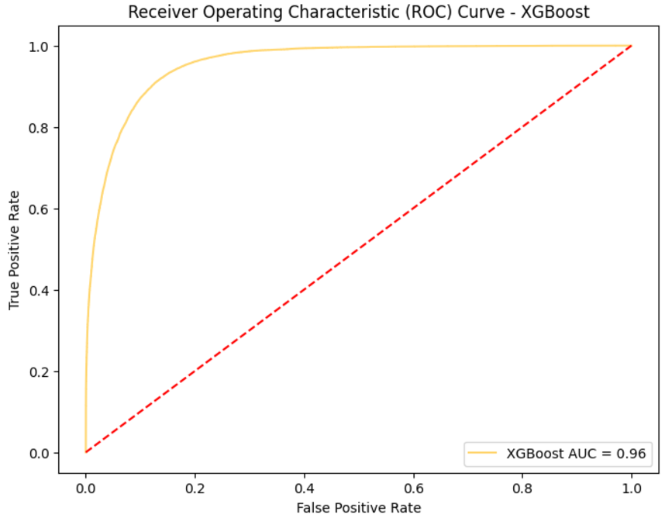
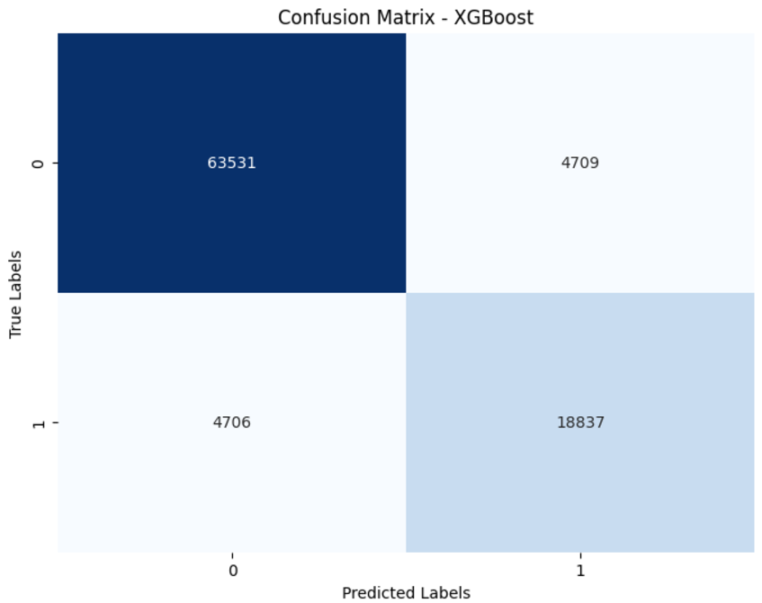
Model Evaluation(XGBoost)
XGBoost Performance Metrics
F1 Score: 0.8001
Precision: 0.8000
Recall: 0.8001
Accuracy: 0.8974
AUC-ROC: 0.9569
Log Loss: 0.2297
Notes:
19

Slide 20
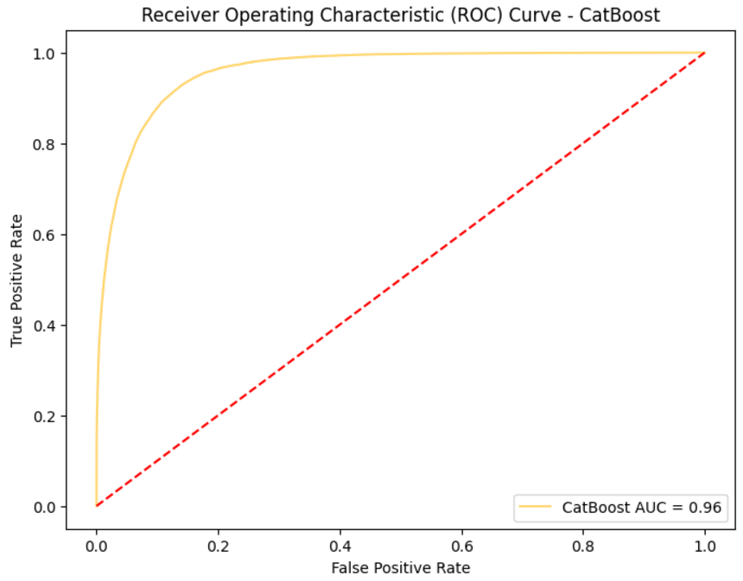
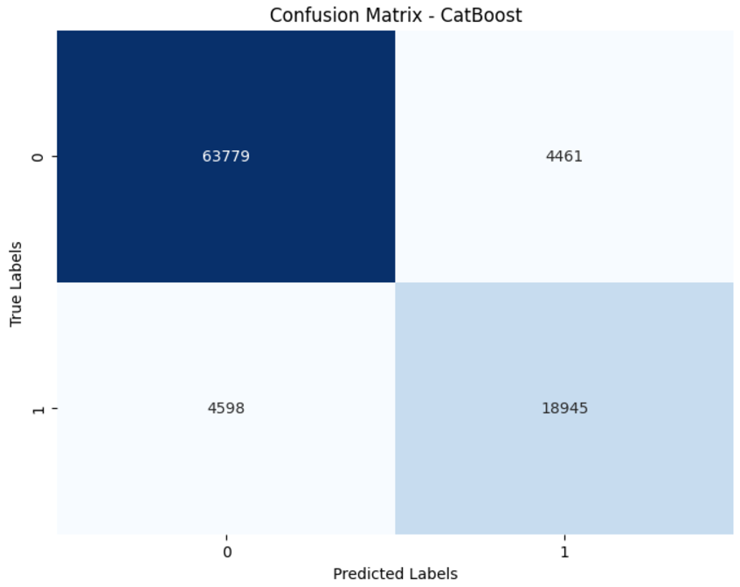
Model Evaluation(CatBoost)
CatBoost Performance Metrics
F1 Score: 0.8070
Precision: 0.8094
Recall: 0.8047
Accuracy: 0.9013
AUC-ROC: 0.9593
Log Loss: 0.2227
Notes:
19

Slide 21
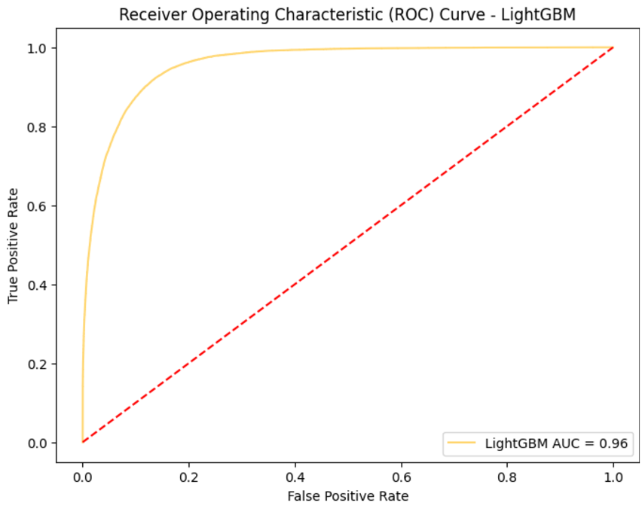
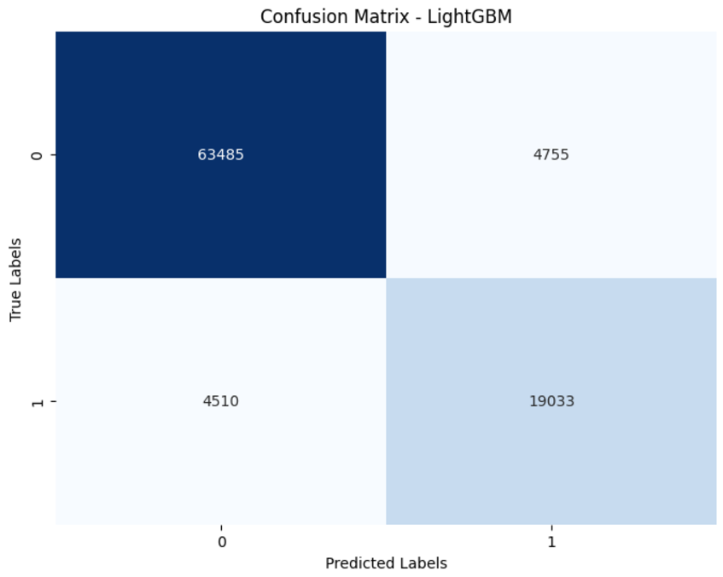
Model Evaluation(LightGBM)
LightGBM Performance Metrics
F1 Score: 0.8043
Precision: 0.8001
Recall: 0.8084
Accuracy: 0.8991
AUC-ROC: 0.9582
Log Loss: 0.2259
Notes:
19

Slide 22
Future Work And Conclusion
Enhanced Feature Engineering: Explore additional features such as behavioral data, external data sources (e.g., credit reports or macroeconomic factors), and temporal patterns like changes in spending or payment behaviors to improve predictive accuracy.
Adopting Advanced Models: Incorporate deep learning models, such as LSTMs, to capture sequential and time-series dynamics in customer behavior, enabling more nuanced predictions.
Handling Class Imbalance: Apply advanced techniques like SMOTE or ADASYN to balance class distribution, improving the model's ability to predict rare default cases accurately.
Ensemble and Hyperparameter Tuning: Use ensemble methods and systematic hyperparameter tuning (e.g., Bayesian Optimization or AutoML) to enhance performance and generalization.
Real-Time Prediction and Explainability : Develop real-time prediction systems using online learning for dynamic updates and integrate explainability tools (e.g., SHAP, LIME) to provide clear insights into model decisions, ensuring trust and regulatory compliance.
Notes:
19

Slide 23
Thank you!

